Slide 1

RUNGTA COLLEGE OF DENTAL SCIENCES & RESEARCH
BACTERIAL ANATOMY
DEPARTMENT OF MICROBIOLOGY

Slide 2
Specific learning Objectives
At the end of this presentation the learner is expected to know ;
Core areas* | Domain ** | Category #
Introduction | Affective | Nice to know
Morphology | Cognitive | Must know
Reproduction in Bacteria | Cognitive | Must know
Bacterial Growth Curve | Cognitive | Must know

Slide 3
Table of Content
Bacterial Morphology
Reproduction in Bacteria
Bacterial Growth Curve

Slide 4
BACTERIAL ANATOMY

Slide 5
Size of Bacteria
Average bacteria 0.5 ‐2.0 um in diam. (RBC is 7.5 um in diam.)
Cocci is 1um & bacillus is 2 -10um x 0.2 - 0.5um
Resolution of unaided eye – 200u
Eukaroytes need structures & organelles
Bacteria are unicellular, free living
Have both DNA & RNA
Belong to kingdom Protista - Prokaryotes, Hackel 1866

Slide 6
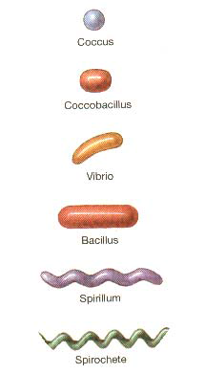
Shapes of Bacteria
Coccus- circular shaped
Chain = Streptococcus
Cluster = Staphylococcus
Bacillus- Rod shaped
Chain = Streptobacillus
Cocco-bacillus
Vibrio = curved
Spirillum
Spirochete

Slide 7
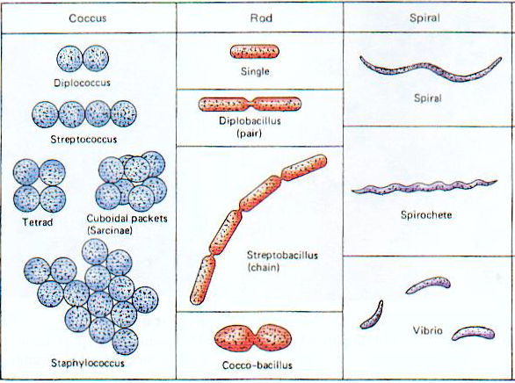

Slide 8
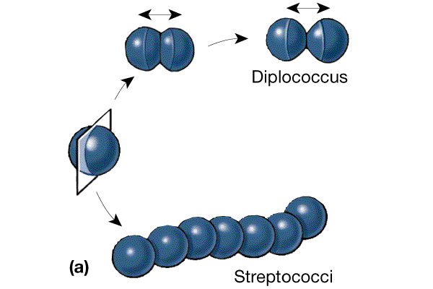

Slide 9
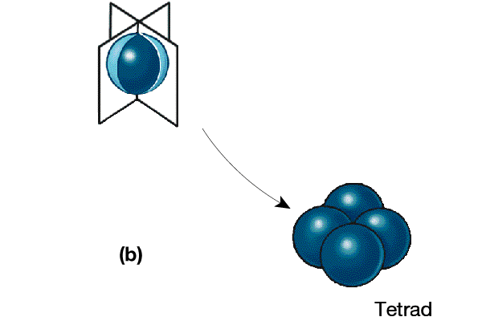

Slide 10
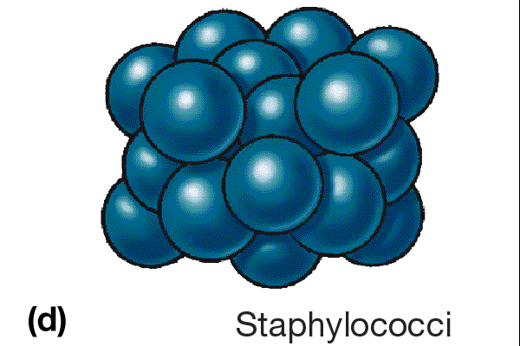

Slide 11
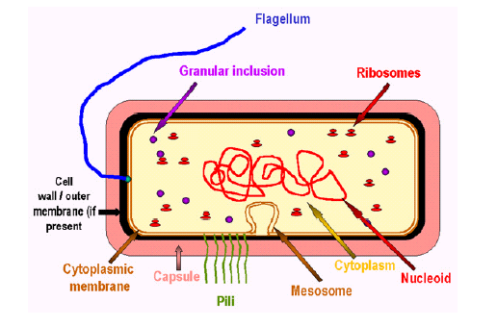

Slide 12
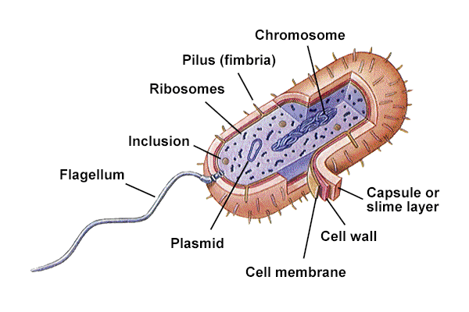
Bacterial Structures
Flagella
Pili
Capsule
Cell Wall
Lipopolysaccharide
Teichoic Acid
Plasma Membrane
Cytoplasm
Inclusion Bodies
Spores

Slide 13
Cell Membrane
Bilayer Phospholipid
Water can penetrate
Flexible
Not strong, ruptures easily -Osmotic Pressure created by cytoplasm
No cell wall- either inhibition or lysozymes of tissue fluid etc.- Protoplst & Spheroplast

Slide 14
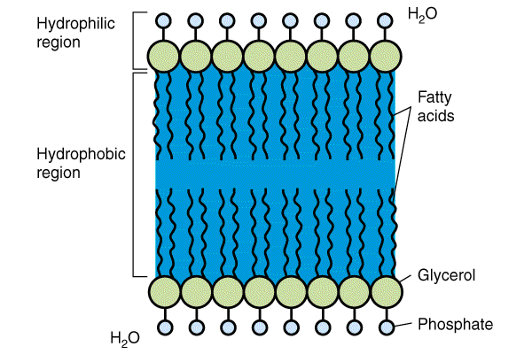

Slide 15
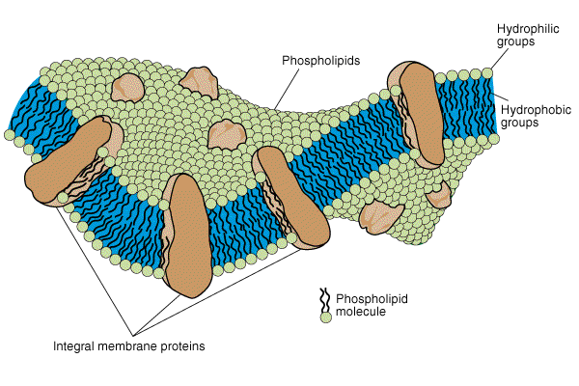

Slide 16
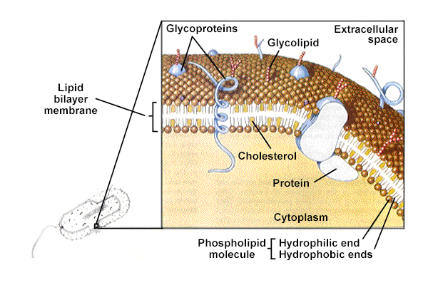

Slide 17
CELL WALL
Peptido‐glycan Polymer (amino acids + sugars)
Unique to bacteria
Sugars; NAG & NAM - N‐acetylglucosamine & N‐acetylmuramic acid
D form of Amino acids used not L form -Hard to break down D form
Amino acids cross link NAG & NAM

Slide 18
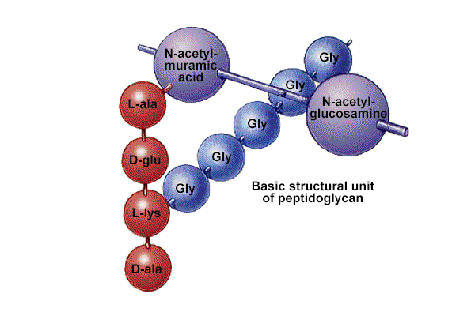

Slide 19
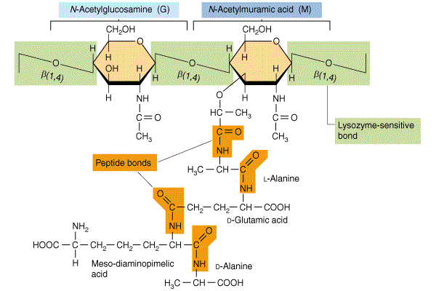

Slide 20
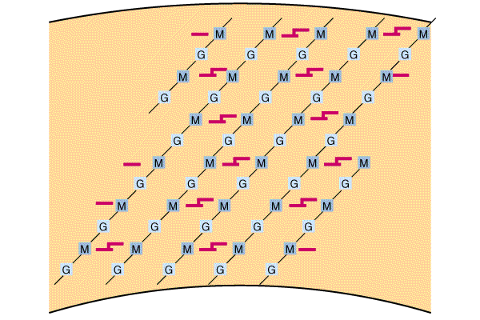

Slide 21
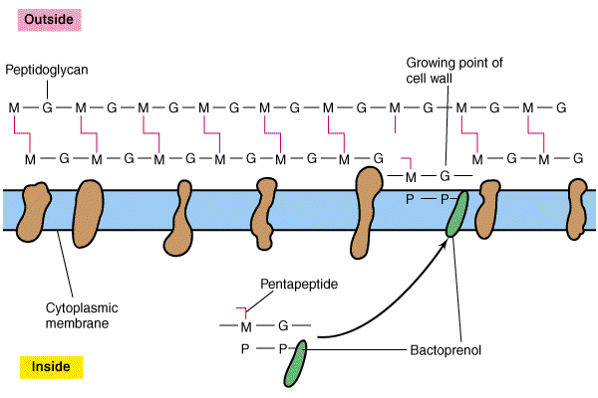

Slide 22
FUNCTIONS OF CELL WALL
Determines shape of bacteria
Strength prevents osmotic rupture
20‐40% of bacteria
Some antibiotics effect directly Penicillin
Mucopeptide – target sites for antibiotics lysozymes & bacteriophages
Protects internal structure

Slide 23
FUNCTIONS OF CELL WALL
Protection of internal structure
Gives rigidity & ductility
Helps in cell division
Resistant to harmful effects of environment
Provides attachment to complement
Can be demonstrated by osmosis, microdissection, electron microscopy & also serology

Slide 24
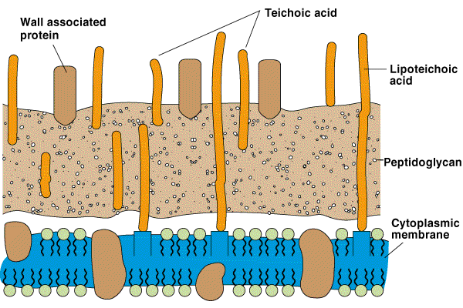
Teichoic Acids
Gram positive only
Glycerol, Phosphates & Ribitol
Attachment for Phages
Exotoxin‐excreted into environment

Slide 25
Lipopolysaccharide (LPS)
Present only in Gram negative bacteria
Endotoxin or Pyrogen - Fever causing
  - Endo‐part of bacteria
Structure- Lipid A
  Polysaccharide O Antigen of E. coli, Salmonella
Alcohol/Acetone removes the LPS layer

Slide 26
LPS
Functions - Toxic; kills mice, pigs, humans Gram negative septicemia; death due to LPS
Pyrogen; causes fever - DPT vaccination always causes fevers
Adjuvant; stimulates immunity
Heat Resistant; hard to remove
Detection - Amoebocytes Lyse in presence of LPS.

Slide 27
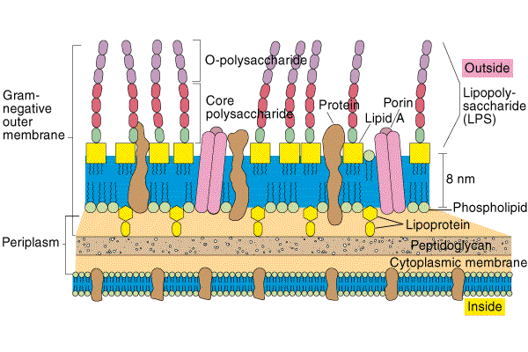

Slide 28
Difference in Cell Wall
Gram negative
Gram positive
Thick peptidoglycan layer
Mucopeptide- 80%
Teichoic acid present making cell wall more acidic
Lipopolysaccharide membrane that is soluble in solvent like acetone and alcohol is absent
Outer membrane having proteins (OMP)and pores (Porins) absent.
Thin peptidoglycan layer
Mucopeptide- 40-60%
Teichoic acid absent so less acidic
Lipopolysaccharide membrane that is soluble in solvent like acetone and alcohol is present.
Outer membrane having proteins (OMP)and pores (Porins) present.

Slide 29
Gram negative
Gram positive
Lysozyme, hypertonic solution – protoplast formed
Takes up Primary Stain during Gram Staining and appear blue-violet .
Does not possess Pili.
Mesosomes are more prominent.
Lysozyme, hypertonic solution – spheroplast formed
Takes up Secondary Stain during Gram Staining and appear pink-red .
Possess Pili.
Mesosomes are less prominent.

Slide 30
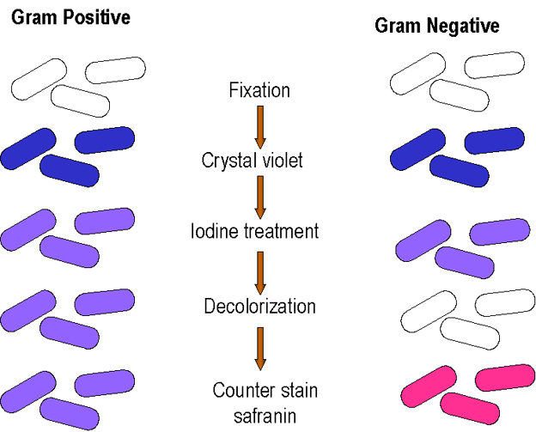
Grams stain = a Differential stain procedure, for differentiating bacteria

Slide 31
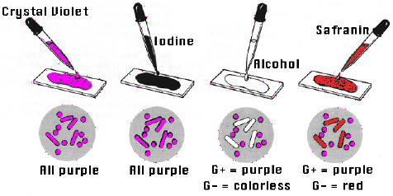
Grams stain = a differential stain procedure, different results, + and (-)

Slide 32
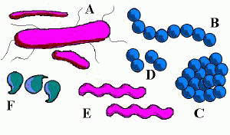
Bacterial cell “shapes” A=bacillus or pl. bacilli B= round, coccus, cocci pl., in chains “Streptococcus) C. Staphylococcus – clusters D= diplococcus E=Spirillum, spirilla pl. (spirochete is a corkscrew shape – not shown) F= vibrio, more comma shaped

Slide 33
WALL-LESS FORMS OF BACTERIA
When bacteria are treated with 1) enzymes that are lytic for the cell wall e.g. lysozyme or 2) antibiotics that interfere with biosynthesis of peptidoglycan, wall-less bacteria are often produced.
Usually these treatments generate non-viable organisms. Wall-less bacteria that can not replicate are referred to as spheroplasts (when an outer membrane is present) or protoplasts (if an outer membrane is not present).
Occasionally wall-less bacteria that can replicate are generated by these treatments (L forms).

Slide 34
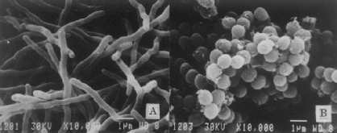
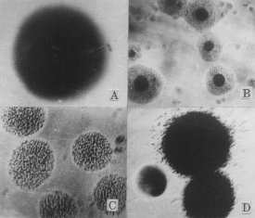

Slide 35
CYTOPLASM
80% Water {20% Salts‐Proteins) Osmotic Shock important
cytoplasmic streaming absent
No organelles (Mitochondria,Golgi, etc.)
Semipermeable
5 – 10 nm in width
Phospholipid with small amount of protein
Sterol absent – (present in Mycoplasma)
Demonstrated by Plasmolysis (Gram negative), electron microscope

Slide 36
FUNCTIONS OF CYTOPLASMIC MEMBRANE
Controls inflow & outflow of metabolites
Permeases helps in passage of selective nutrients
Cytoplasmic membrane contains respiratory enzymes & pigments, enzymes of TCA cycle, polymerizing enzymes(makes substance of cell wall & extra cellular structure)
Mechanical strength to cell
Helps in DNA replication

Slide 37
CAPSULE OR SLIME LAYER
Glycocalyx ‐Polysaccharide on external surface
Adhere bacteria to surface - S. mutans and enamel of teeth
Prevents Phagocytosis - Complement can’t penetrate sugars

Slide 38
SLIME LAYER
Viscid carbohydrate material outside cell wall
Produce mucoid colonies on agar media
Little affinity for basic dye.
Ex. Klebsiella

Slide 39
CAPSULE
Gelatinous secretion of bacteria organized as thick coat around cell wall.
Capsulated bacteria are usually non-motile as flagella remains unfunctional in presence of capsule.
Capsules develops in presence of high sugar conc., blood serum, in living host
Thinner capsule – microcapsule – meningococci, Str. pyogens, H. influenza
Polysaccharide – Pneumococci, Klebsiella
Polypeptide – Bacillus anthracis
Hyaluronic acid – Str. pyogens
No affinity for dye.

Slide 40
Negative staining with India Ink – capsule seen as halo
Staining using copper salt as mordant
Serology
Capsule + Anti Capsular Serum = capsule becomes swollen and prominent due to increase in refractive Index- Can be easily seen by negative staining (Quellung reaction)
FUNCTIONS OF CAPSULE:
Protection against deleterious agents & lytic enzymes
Inhibits phagocytosis – virulent factor
Capsular antigen is hapten & specific

Slide 41
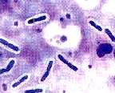
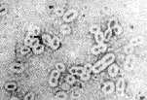
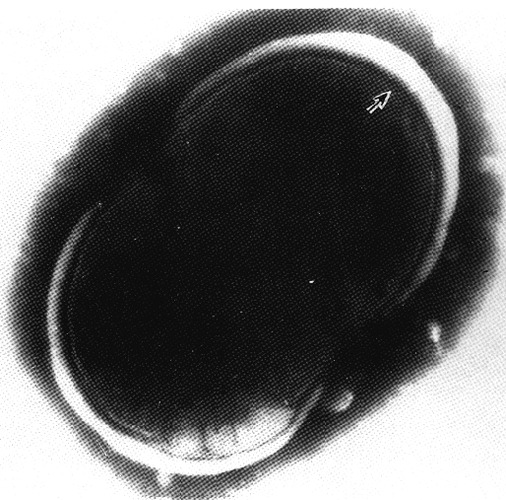
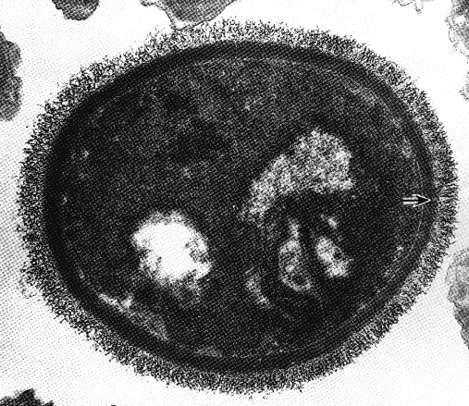

Slide 42
negative staining technique. The bacterial cells and the background stain, but the capsules do not. The capsules are seen as unstained “halos” around the bacterial cells. Quellung Reaction

Slide 43
NUCLEUS
DNA is long(1000u), tightly coiled filament, Haploid - Advantages of 1N DNA over 2N DNA
Nuclear membrane & nucleolus absent
One per cell
More efficient; grows quicker
Mutations allow adaptation to environment quicker
Plasmids; extra circular DNA - Antibiotic Resistance, toxigenicity, virulence

Slide 44
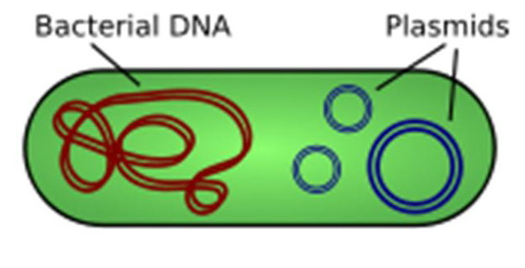
Bacterial chromosome and an extra-chromosomal “plasmid”

Slide 45
Flagella
Motility ‐movement
Swarming occurs with some bacteria - Spread across Petri Dish
Proteus species most evident
Long & contractile
Arrangement basis for classification :- Monotrichous; 1 flagella
Lophotrichous; tuft at one end
Amphitrichous; both ends
Peritrichous; all around bacteria

Slide 46
Made of flagellin protein
Antigenic
Motility – hanging drop
Demonstrated by dark Ground Microscopy, mordanting, Electron Microscope

Slide 47
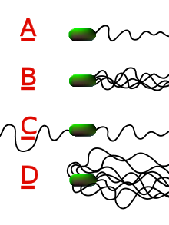
CLASSIFICATION OF BACTERIA ON THE BASIS OF “Flagella”
MONOTRICHOUS
LOPHOTRICHOUS
AMPHITRICHOUS
PERITRICHOUS

Slide 48
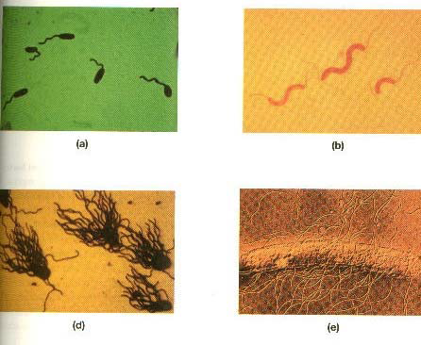

Slide 49
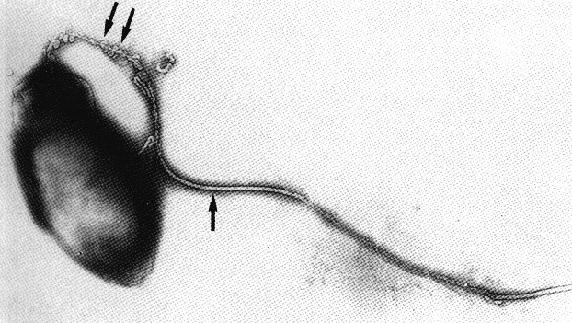
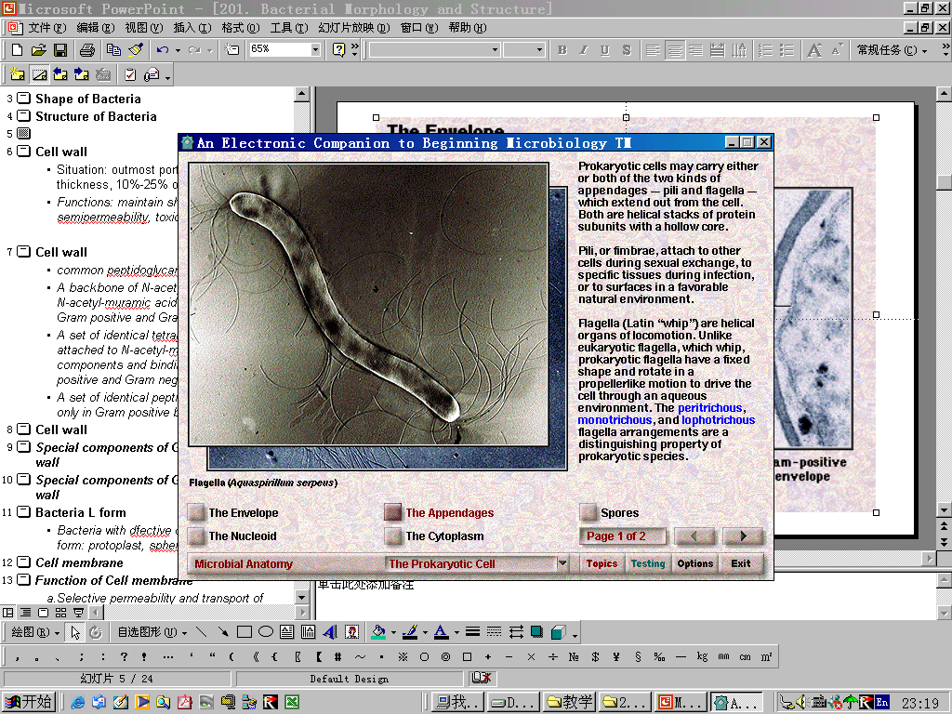
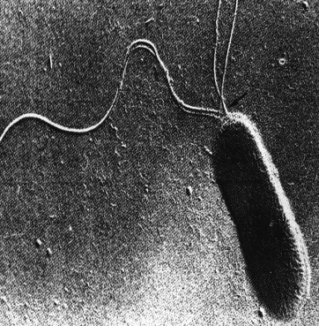
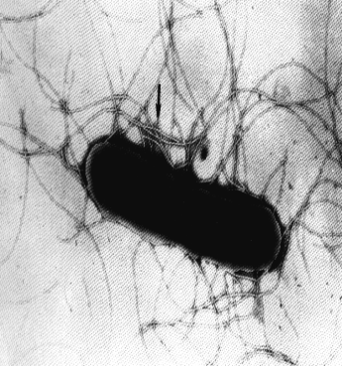
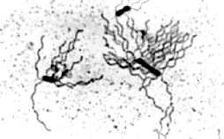
Monotrichate Amphitrichate Lophotrichate Peritrichate

Slide 50
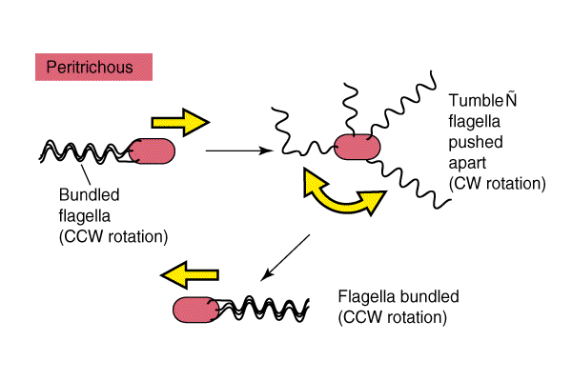
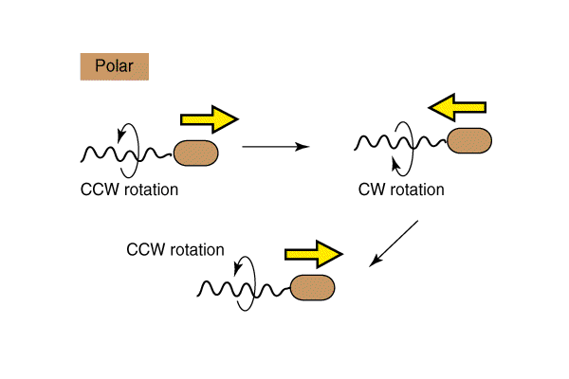

Slide 51
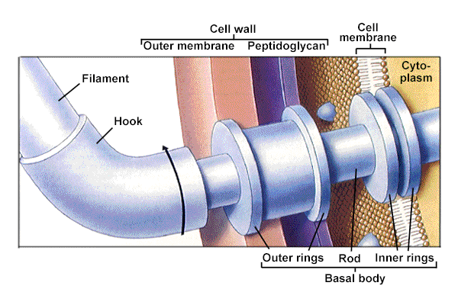

Slide 52
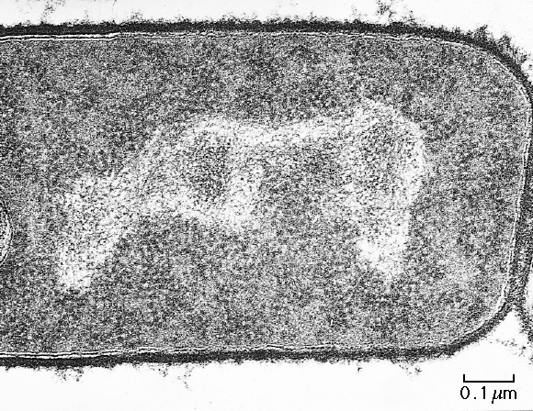
RIBOSOMES
proteins and RNA
prokaryotic ribosomes are smaller than eukaryotic ribosomes
protein synthesis
“granular”
appearance
70s

Slide 53
POLYSOMES – group of Ribosomes linked together like beads of chain by mRNA
MESOSOMES – vesicular, convoluted, multi-laminated, formed by invaginations of plasma Membrane in cytoplasm
Prominent in Gram Positive
Helps in DNA segregation & cross wall formation during cell division
Sites of respiratory enzymes
Coordinates nuclear & cytoplasmic division
Responsible for DNA compartmenting during sporulation

Slide 54
INTRACYTOPLASMIC INCLUSIONS
GLYCOGEN (Enteric bacillium), POLY-BETIS HYDROXYBUTYRATE (Bacillus & Pseudomonas) & BABES- ERNST(Corynebacterium, Yersinia)
Types
Volutin granules(Metachromatic, Babes Ernst) –basophilic polymetaphosphate bodies – serves as reserve for energy & phosphate for cell metabolism – stained by albert, Neisser stain
Polysaccharide Granules – used as carbon source when protein & nucleic acid synthesis is resumed

Slide 55
3) Intracellular granules – Sulphur oxidizing bacteria convert excess H2S to Intracellular granules of Sulphur element
4) Lipid Inclusion – storage product – stained by fat soluble dyes – Sudan black
5) Vacuoles – fluid containing cavities separated from cytoplasm by membrane

Slide 56
Pili
Short protein appendages smaller than flagella – antigenic
Adhere bacteria to surfaces-E. coli has numerous types - K88, K99, F41, etc.
Antibodies to it will block adherence
F‐pilus; used in conjugation - Exchange of genetic information
Flotation; increase buoyancy - Pellicle (scum on water)
More oxygen on surface
Demonstrated by – Electron Microscope, Hemagglutination

Slide 57
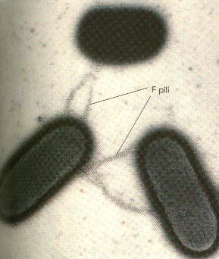

Slide 58
SPORES
Sporulation is the process of producing spores. Fungi, certain plants and bacteria also undergo sporulation, though the process usually refers to the process of bacteria forming spores. Spores allow bacteria to survive in extreme conditions they are not suited to, including very dry, acidic or cold conditions.

Slide 59
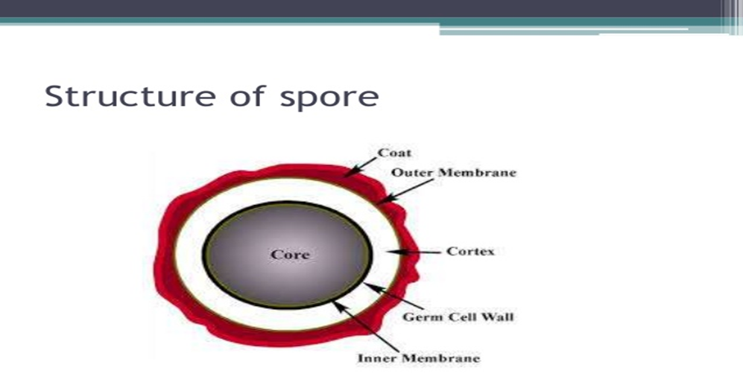

Slide 60
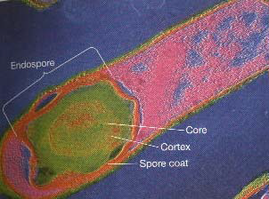

Slide 61
Endospores
Resistant structure - Heat, irradiation, cold,Boiling >1 hr still viable
  Takes time and energy to make spores
  Bacillus stearothermophilus ‐spores Used for quality control of heat sterilization equipment
  Bacillus anthracis ‐spores Used in biological warfare
  killed when Autoclaving & Hot Air Oven
  has 5-20% Dipicolinic acid with Mg++ & Ca++

Slide 62
Low water content, low metabolic activity, low enzymatic activity & high contents of Ca++ & Mg++ & dipicolinic acid
Resistant to heat, drying, freezing & toxic chemicals
Location important in classification - Central, Sub-terminal, Terminal
1 bacteria = 1 spore & vice versa
GPB – Aerobic (Bacillus anthracis, Bacillus subtilis), Anaerobic (Cl.tetani, Cl. perfringens, Cl. botulinum), Gram positive coccus( Spore Sarcina)
GNB – Coxiella burnetii

Slide 63
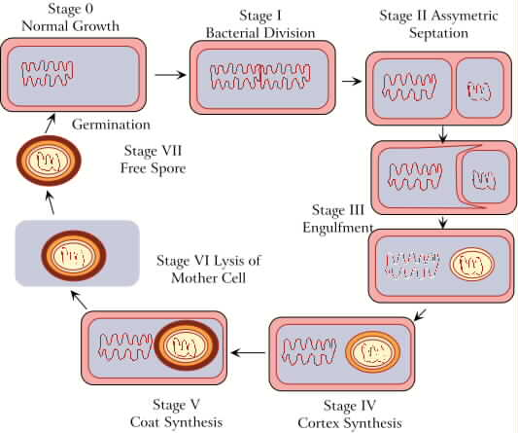

Slide 64
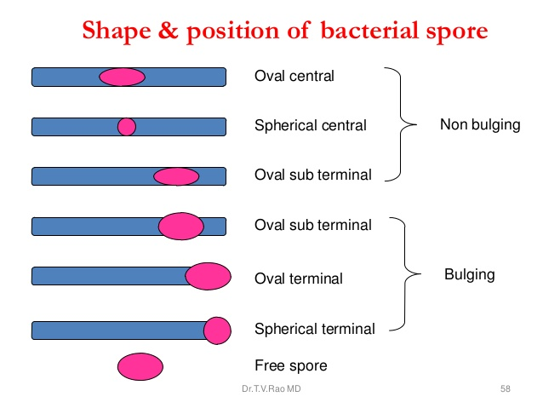

Slide 65
BACTERIAL REPRODUCTION & MULTIPLICATION

Slide 66
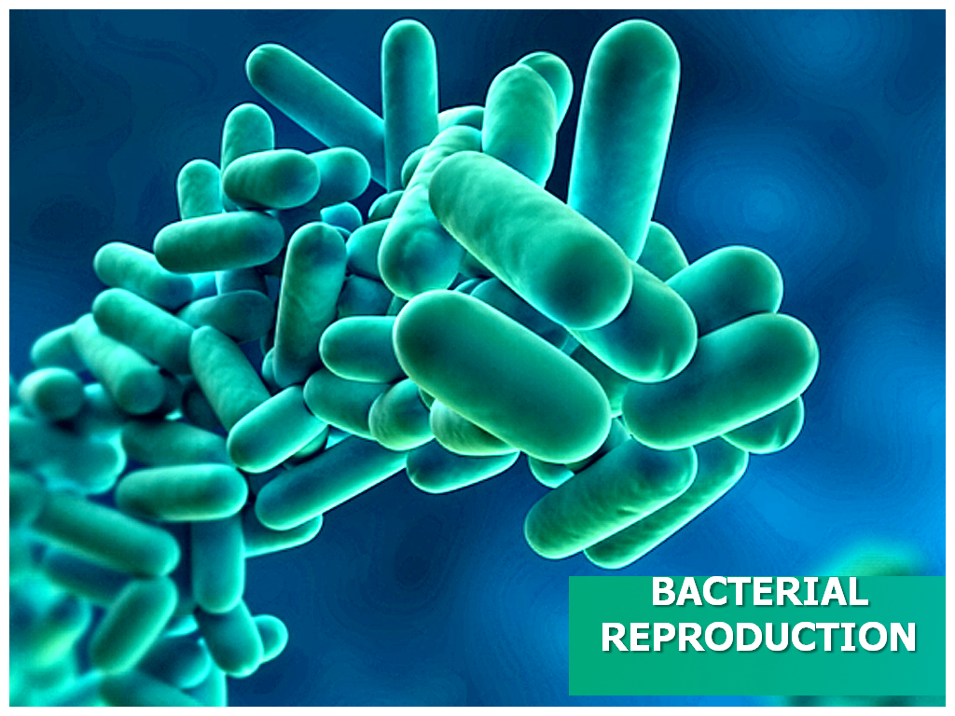

Slide 67
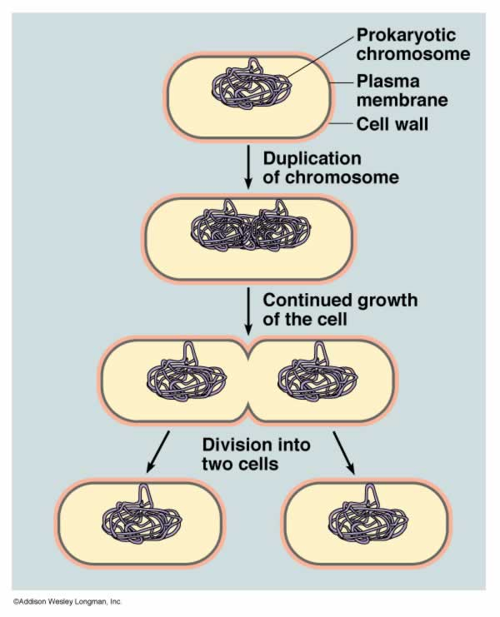
Bacteria divides by “binary fission”

Slide 68
The process of binary fission in bacteria involves the following steps. First, the cell's DNA is replicated. The replicated DNA copies then move to opposite poles of the cell in an energy-dependent process. The cell lengthens. Then, the equatorial plate of the cell constricts and separates the plasma membrane such that each new cell has exactly the same genetic material.
The bacterium before binary fission is when the DNA is tightly coiled.
The DNA of the bacterium has uncoiled and duplicated.
The DNA is pulled to the separate poles of the bacterium as it increases size to prepare for splitting.
The growth of a new cell wall begins to separate the bacterium.
The new cell wall fully develops, resulting in the complete split of the bacterium.
The new daughter cells have tightly coiled DNA rods, ribosomes, and plasmids; these are now brand new organisms.

Slide 69
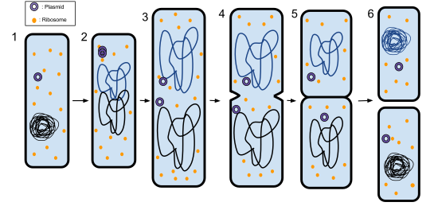

Slide 70
Bacterial Growth
Exponential growth via binary fission
Generation or doubling time
(from 20 min to 24 h)
Phases of growth
  Lag phase
  Exponential (logarithmic [log]) phase
  Stationary phase
  Death phase
Compare growth in liquid and on solid media

Slide 71
Phases of Growth
Lag
  Adapt to nutrients
Log
  Active growth
Stationary
  Death = Growth rate
Death
  Nutrients consumed
  pH too low
Optimize curves in production

Slide 72
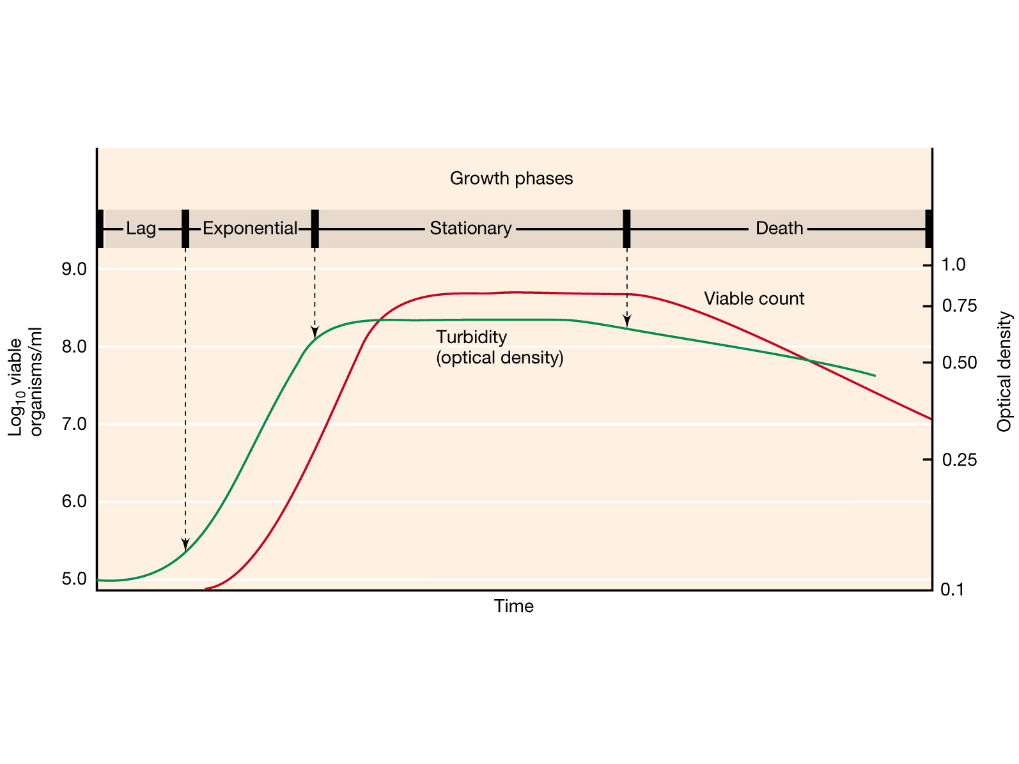
Bacterial growth curve in batch culture
Exponential growth = balanced growth
Notes:
Figure: 06-08
Caption: Typical growth curve for a bacterial population.
Four characteristic phases of the growth cycle are recognized.
1. Lag Phase. Immediately after inoculation of the cells into fresh medium, the population remains temporarily unchanged. Although there is no apparent cell division occurring, the cells may be growing in volume or mass, synthesizing enzymes, proteins, RNA, etc., and increasing in metabolic activity.
The length of the lag phase is apparently dependent on a wide variety of factors including the size of the inoculum; time necessary to recover from physiacal damage or shock in the transfer; time required for synthesis of essential coenzymes or division factors; and time required for synthesis of new (inducible) enzymes that are necessary to metabolize the substrates present in the medium.
2. Exponential (log) Phase. The exponential phase of growth is a pattern of balanced growth wherein all the cells are dividing regularly by binary fission, and are growing by geometric progression. The cells divide at a constant rate depending upon the composition of the growth medium and the conditions of incubation. The rate of exponential growth of a bacterial culture is expressed as generation time, also the doubling time of the bacterial population. Generation time (G) is defined as the time (t) per generation (n = number of generations). Hence, G=t/n is the equation from which calculations of generation time (below) derive.
3. Stationary Phase. Exponential growth cannot be continued forever in a batch culture (e.g. a closed system such as a test tube or flask). Population growth is limited by one of three factors: 1. exhaustion of available nutrients; 2. accumulation of inhibitory metabolites or end products; 3. exhaustion of space, in this case called a lack of "biological space".
During the stationary phase, if viable cells are being counted, it cannot be determined whether some cells are dying and an equal number of cells are dividing, or the population of cells has simply stopped growing and dividing. The stationary phase, like the lag phase, is not necessarily a period of quiescence. Bacteria that produce secondary metabolites, such as antibiotics, do so during the stationary phase of the growth cycle (Secondary metabolites are defined as metabolites produced after the active stage of growth). It si during the stationary phase that spore-forming bacteria have to induce or unmask the activity of dozens of genes that may be involved in sporulation process.
4. Death Phase. If incubation continues after the population reaches stationary phase, a death phase follows, in which the viable cell population declines. (Note, if counting by turbidimetric measurements or microoscopic counts, the death phase cannot be observed.). During the death phase, the number of viable cells decreases geometrically (exponentially), essentially the reverse of growth during the log phase.

Slide 73
GROWTH OF BACTERIA
Under ideal conditions, bacteria grow very rapidly: some double in number every 20 minutes.
Doubling in number: 1-2-4-8-16-… is exponential growth. It starts off slowly, but once going the number of bacteria increase very rapidly
Usually some nutrient runs short, or waste material builds up, and growth ceases. Eventually a die-off occurs, reducing the number of live bacteria.

Slide 74
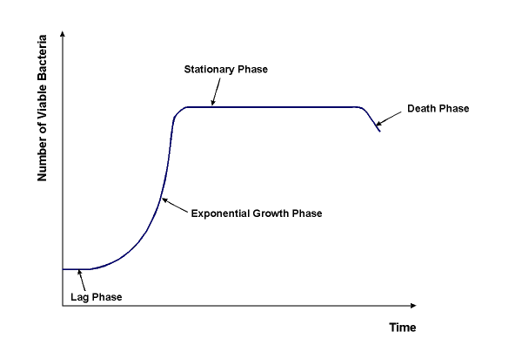

Slide 75
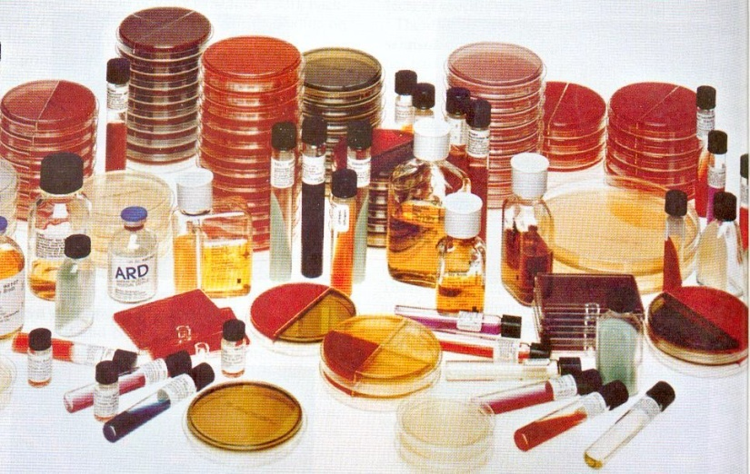
STAINING METHODS
Simple staining;
Differential staining(Gram stain, Acid-fast stain),
Special staining ( Negative stain, Spore stain, Flagella stain)

Slide 76
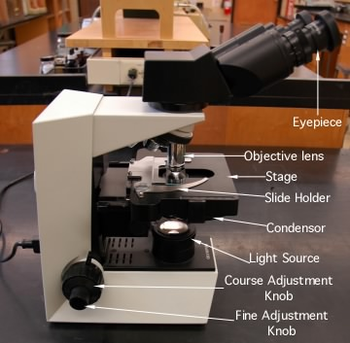
METHODS
MICROSCOPE
Light Microscope
Electron Microscope
Dark-field Microscope
Phase-Contrast Microscope
Fluorescence Microscope
Co-focal Microscope

Slide 77
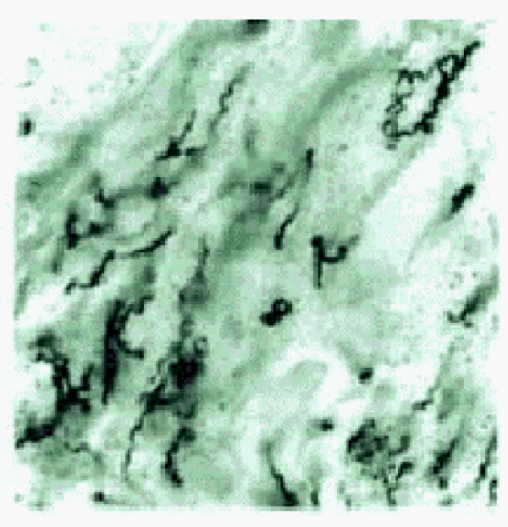


Spirochetes
Long, helical bacteria which swim by spinning like corkscrews
Treponema pallidum
causes syphilis
Borrelia burgdorferi
causes Lyme disease
Leptospira interrogans
causes leptospirosis

Slide 78






Gram negative, facultatively anaerobic rods
Escherichia coli
(urinary tract infections)
Salmonella (typhoid fever, food poisoning)
Shigella sonnei (shigellosis diarrhea)
Vibrio cholerae
(cholera diarrhea)
Haemophilus influenzae
(ear infections, meningitis)
Serratia marcescens
(urinary, resp tract infections)

Slide 79



Gram negative aerobic rods and cocci
Pseudomonas aeruginosa
(burn, wound, & other infections)
Neisseria gonorrhoeae
(gonorrhea)
Bordatella pertussis
(pertussis/whooping cough)

Slide 80


Rickettsias and Chlamydias obligate intracellular parasites
Rickettsia prowazekii
(typhus)
Chlamydia trachomatis
(urethritis - most common STD)

Slide 81

Mycoplasmas
No cell wall, intracellular parasite, small size,
unusual sterols in cell membrane
Mycoplasma pneumoniae
(“walking pneumonia”)

Slide 82



Gram positive cocci
Staphylococcus
aureus
Streptococcus pneumoniae
Streptococcus
pyogenes

Slide 83



Endospore forming bacteria
Clostridium
tetani
Bacillus
anthracis
Clostridium
botulinum

Slide 84


Mycobacteria
Thick waxy lipids in cell wall (acid fast)
Mycobacterium tuberculosis
Mycobacterium leprae

Slide 85

Dichotomous Key

Slide 86
TAKE HOME MESSAGE/ FOR THE TOPIC COVERED (SUMMARY)
Knowledge about Bacterial Shapes & Size
Brief idea about Reproduction in Bacteria
Bacterial Growth Curve

Slide 87
REFERENCES
Microbiology – Prescott, et al.
Microbiology – Bernard D. Davis, et al.
Clinical & Pathogenic Microbiology – Barbara J Howard, et al.
Immunology an Introduction – Tizard.
Immunology 3rd edition – Evan Roitt, et al.
Medical Microbiology – Greenwood
Textbook of Microbiology – Ananthnarayan
The short Text Book of Microbiology – Satish Gupte

Slide 88
Question & Answer Session
Students should be given opportunity to ask question for clarifying for their understand/ confusions. Teachers must spend 5-10 minutes for this to improve the output.

Slide 89
THANK YOU

